Slide 1

TIDCO
TANSAM
GOVT OF TN
SIEMENS
TN SKILL
SMART NAVIGATION AID FOR VISUALLY IMPAIRED PEOPLE
Malathi S
REG NO: 422423106023
Dept of ECE IV Year
University College of Engineering Tindivanam

Slide 2
TIDCO
TANSAM
GOVT OF TN
SIEMENS
TN SKILL
Problem Statement
Traditional Cane Limitations
Cannot detect knee-level or head-level obstructions.
Terrain Hazards
Fails to anticipate sudden drop-offs and deep potholes.
Environmental Risks
No detection for toxic gas leaks or low-visibility nighttime hazards.

Slide 3
TIDCO
TANSAM
GOVT OF TN
SIEMENS
TN SKILL
Objective
Core Goal
Develop an ESP32-based multi-hazard smart assistive aid.
Feedback Mechanism
Provide real-time tactile and audio alerts to enhance spatial awareness and user safety.

Slide 4
TIDCO
TANSAM
GOVT OF TN
SIEMENS
TN SKILL
Hardware Components
Microcontroller
ESP32 NodeMCU
Distance
HC-SR04 Ultrasonic Sensor
Drop Detection
IR Sensor
Environmental
MQ Gas Sensor
Tactile Actuator
SG90 Servo Motor
Alerts
Piezo Buzzer & High-Intensity LED

Slide 5
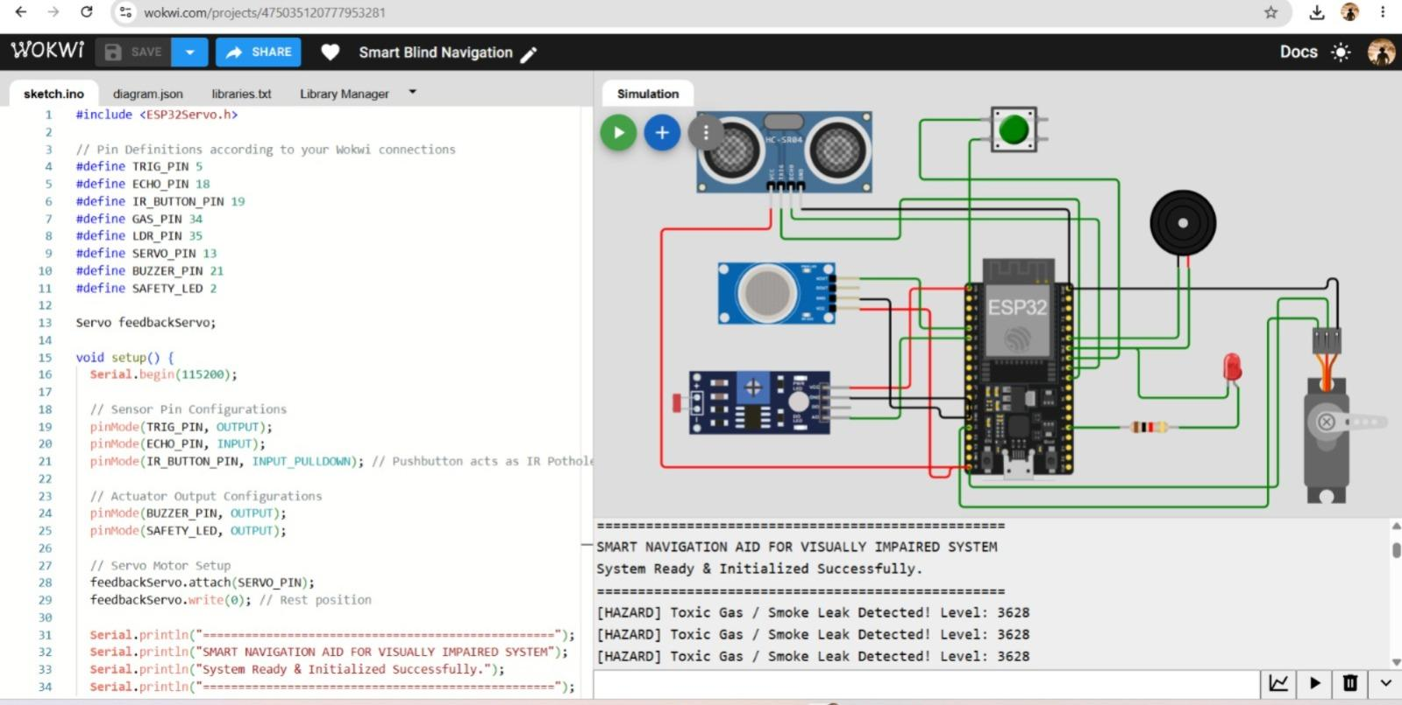
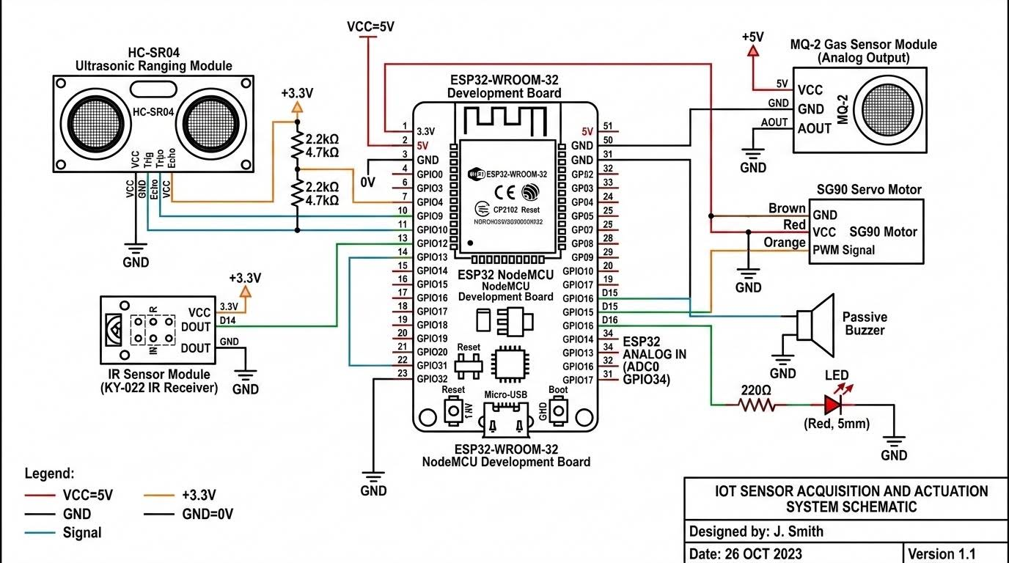
TIDCO
TANSAM
GOVT OF TN
SIEMENS
TN SKILL
Circuit Diagram

Slide 6
TIDCO
TANSAM
GOVT OF TN
SIEMENS
TN SKILL
Working Principle
Ultrasonic Ranging
Detects forward obstacles in real-time.
IR Drop Sensing
Identifies staircases and potholes.
Servo Actuation
Delivers a 60° palm tap for silent tactile feedback.
Illumination
Automatic LED activation for nighttime visibility.

Slide 7
TIDCO
TANSAM
GOVT OF TN
SIEMENS
TN SKILL
Software Used
IDE
Arduino IDE
Language
Embedded C++
Dependencies
Standard ESP32 libraries
Testing
Wokwi IoT Simulator

Slide 8
TIDCO
TANSAM
GOVT OF TN
SIEMENS
TN SKILL
System Flowchart
Start
Read Sensor Array
Threshold Decision
Trigger Actuators
Loop

Slide 9
TIDCO
TANSAM
GOVT OF TN
SIEMENS
TN SKILL
Advantages
Discreet Alerts
Silent tactile feedback is effective even in noisy traffic.
Comprehensive
Multi-hazard safety covering obstacles, drops, and gases.
Accessible
Highly affordable and fully rechargeable design.

Slide 10
TIDCO
TANSAM
GOVT OF TN
SIEMENS
TN SKILL
Applications
Urban Mobility
Safe walking assistance on crowded sidewalks.
Fall Prevention
Early warning for staircases and open potholes.
Indoor Safety
Domestic gas leak alerts for home environments.

Slide 11
TIDCO
TANSAM
GOVT OF TN
SIEMENS
TN SKILL
Future Scope
Location Tracking
GPS integration for live monitoring.
Emergency Alerts
GSM SOS SMS system for immediate assistance.
THANK YOU
Presenter
Malathi S
Advanced Detection
AI vision camera for object recognition.

